Slide 1

Destination Travel Weather App
Chase Follett
Cody Chen
Evan Gerweck
Alessa Loor

Slide 2
Elevator Speech
This application is best for users who are on the go. It allows you to search for any location you are traveling to, and it displays a five-day forecast of the city you searched for. It displays a UV index, humidity, temperature, current date, an icon of current weather condition, and also a live webcam of the set location. Anything that is searched will be stored in local storage to keep the user's data.

Slide 3
Users Story
When I open the application, I am presented with a screen that has a search location feature. When I search the destination, the results bring up a page displaying a live webcam of the location. In addition to the live picture, I am presented with the current weather conditions; high’s and low’s for the day, a five-day forecast, humidity %, wind speed, and a UV index. I can then do another search for another destination, and the application will pull up the information for that location. When I am done, I can clear my searches or keep them saved if I would like to view the page again.

Slide 4
Technologies Used
Technologies Used & IPA’S
Tasks
Ajax
APIS
JavaScript
Webcams
jQuery
Local storage
Travel API (https://api.windy.com/webcams)
Open Weather API (https://openweathermap.org/api)
Cody- weather forecasts and accessing weather API’s
Evan- html, styling
Chase- travel webcam API
Alessa- CSS, PowerPoint,

Slide 5

Successes & Challenges
Successes
pulling live current data from API’S
Pulling them into one application
Polish user interface and interactivity
Easy to use
GitHub Repositories
Mobile interface
Challenges
Accessing & storing user information into local storage
accessing 3rd parties API’S
Saving users input
GitHub/branches with multiple collaborators

Slide 6
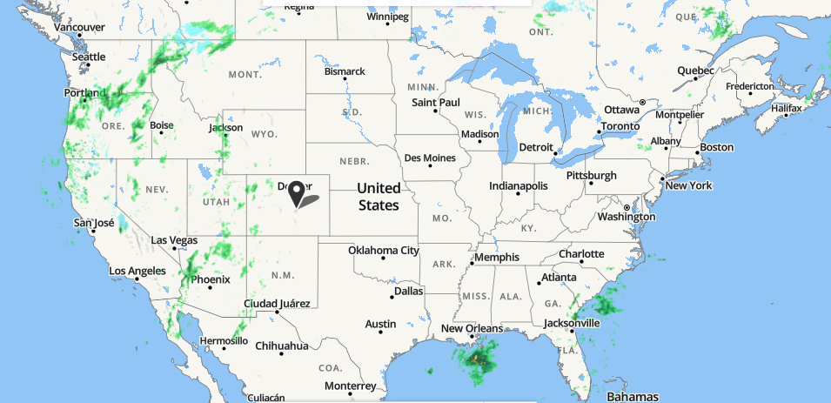
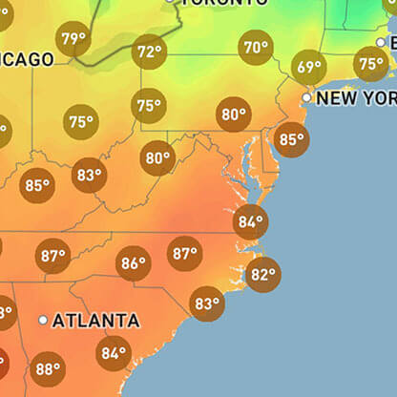

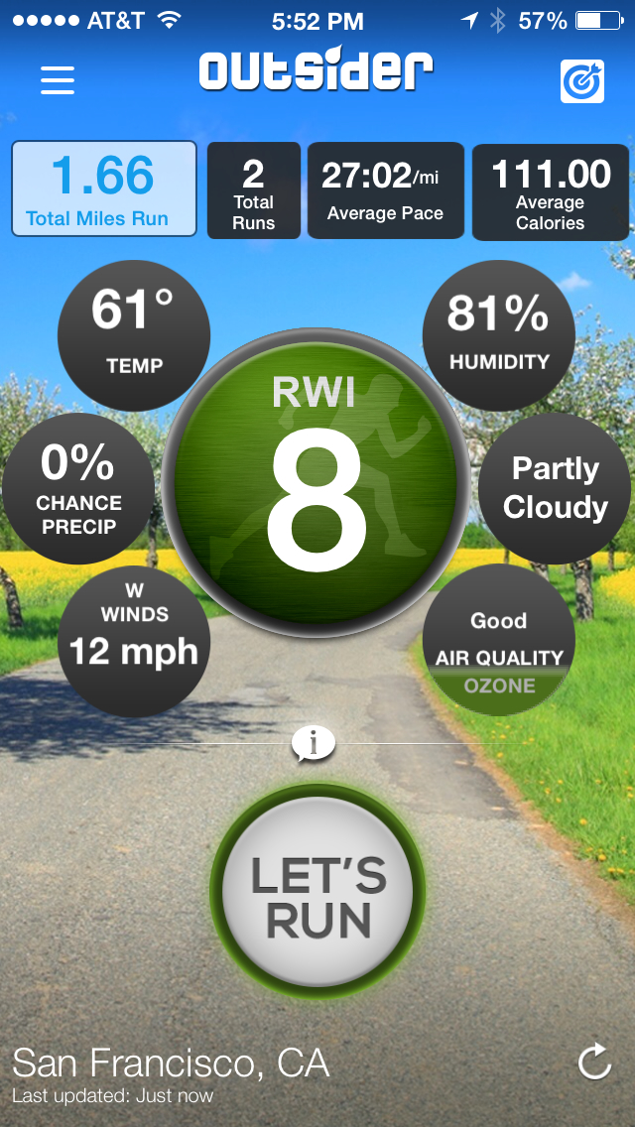
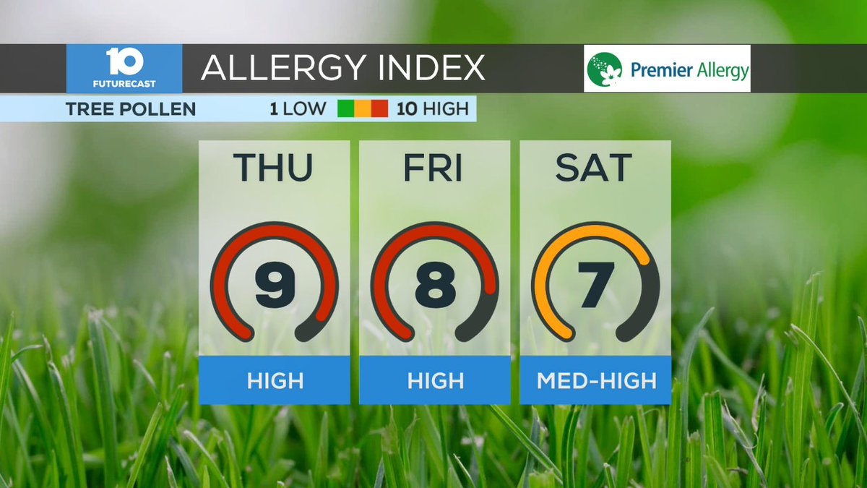
Future Development
In future iterations we would:
Deploy more web cams
Set up history on the web cam page
Forecast radar map
New sections with braking weather news
Allergy index
Running weather condition index

Slide 7
Links https://github.com/clf9008/Project1

